Slide 1
SoftLayer Program for Partners
Notes:
June 2016
Ivan Aguilera aguileri@us.ibm.com

Slide 2
Hosting your own POC/Demo & Proof of Platform
What does this mean?
Partners who want to have their own Cloud provisioning system can do so by individually opening an account DIRECTLY with IBM SoftLayer.
What’s the benefit
Partners can have their own account with 24x7 availability
IBM can easily share our Demo cloud based images with partners so that they are immediately available to them.
No expiration on your own hosted provisioned images.
Can be used for POC’s or any engagement longer than the short periods IBM provides for free.
Also ideal for Mobile demos.
Customize your Demo images and presentations without having to worry about loosing the content because of an expired instance.
Available on a WW basis.
Additionally you can create your own SW images to be hosted.
Low cost , high speed, availability and great performance environment

Slide 3

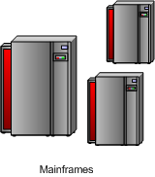




SoftLayer
IBM Demo Images
Partner Controlled Images
IBM SHARED Image

Slide 4
Please read carefully:
DO NOT PROVISION AN EMPTY SERVER , we cannot move one of our images unto it, and you will have to pay for that empty server.
SoftLayer account can be established without initially ordering a server or billable services by creating an object storage order.
As object storage remains zero dollars until you begin using it, you are essentially submitting a zero dollar order for the system to create a customer account to access the web portal and platform with.
On the order page, the default datacenter will appear as DAL05, and you will need to provide credit card details. Once inside the portal, you will notice on the object storage page that a datacenter still needs to be selected and object storage containers be created before you can begin storing files.
Once done, storage starts at USD0.04c/GB/month but only when usage begins.
Further, you can remove your credit card details through the users page and select manual payment / direct debit instead.
Note that creating the account establishes the monthly billing date for future invoices, e.g., creating an account on an specific date will result in the account billing date being the same day of each month.

Slide 5
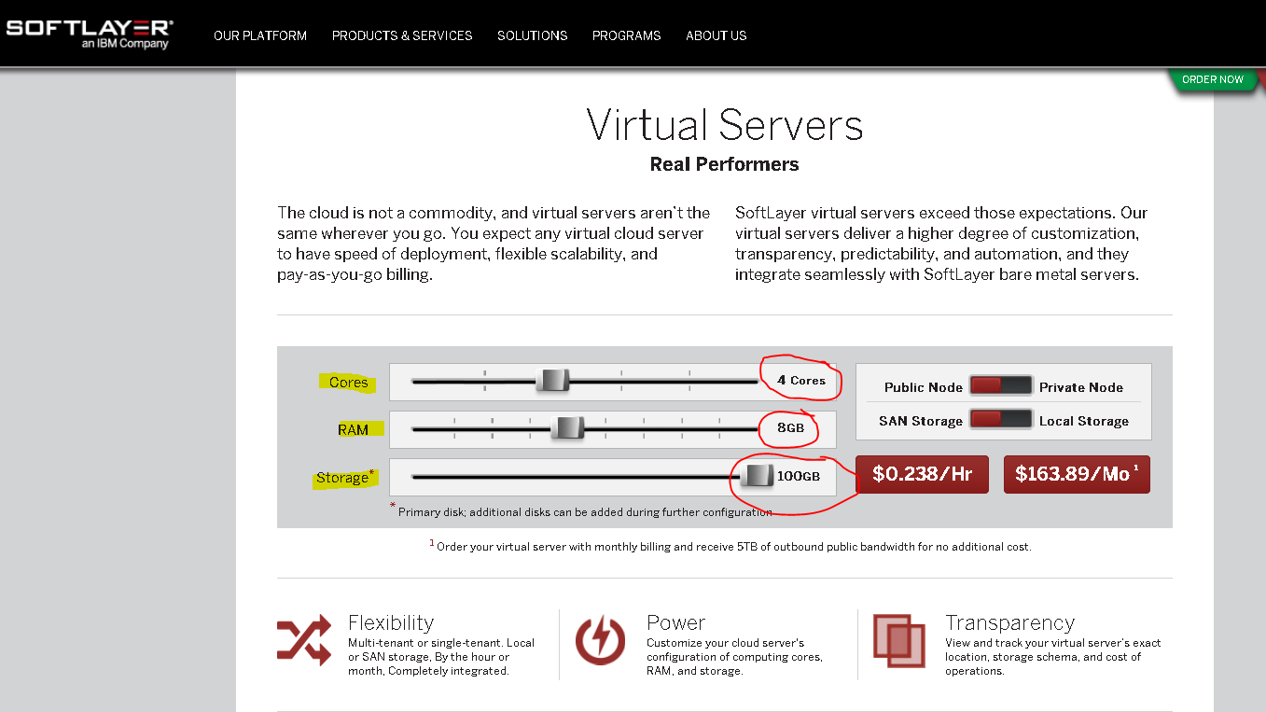
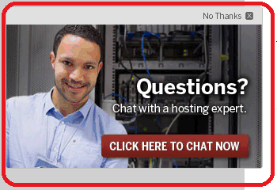
http://www.softlayer.com/virtual-servers
TEST-Price the configuration you would like, choose the characteristics you need to see how much it would cost
Use the chat option to clear out any questions you may have…
Move to change the number of cores and memory
Click on price to go to next page and choose more options

Slide 6

Once your account is created …

Slide 7
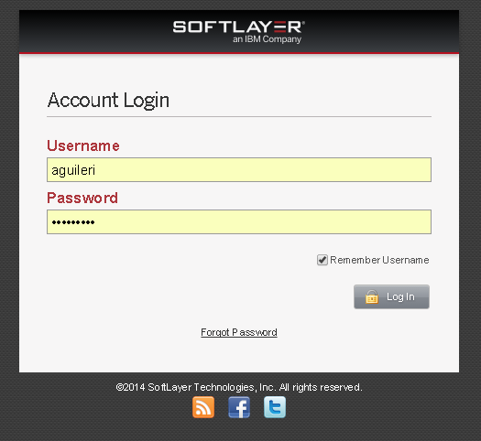
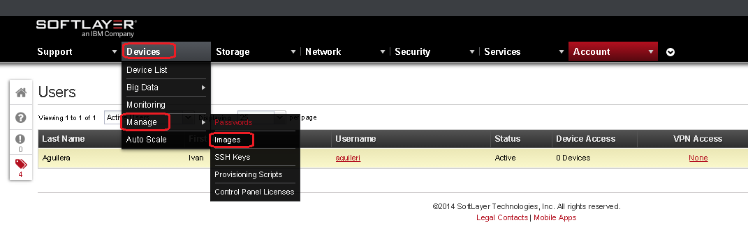
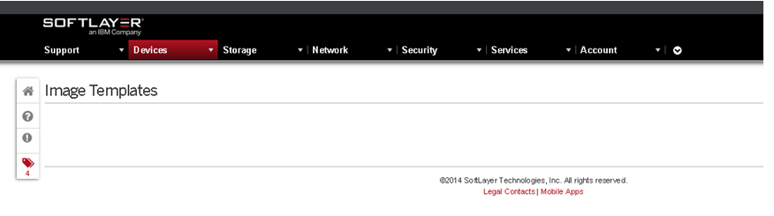
Login to the Admin interface: https://control.softlayer.com/
When you first create an account, your image container will be empty.
You will also be able to have many users (password protected) in your account.
Administer your account, storage, security, services, etc

Slide 8
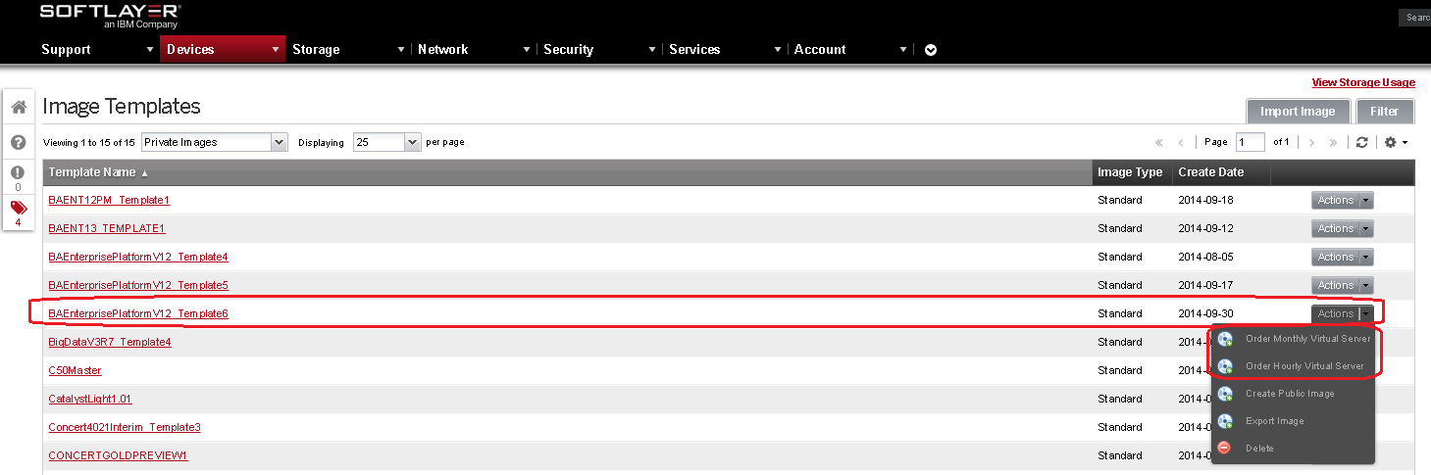
Once any image is either created by the partner or shared by IBM with the partner, they will have it available on their list and can proceed to order the provision of this image by choosing it and selecting an [Action] . For example Order a Monthly or Hourly server with the selected image

Slide 9
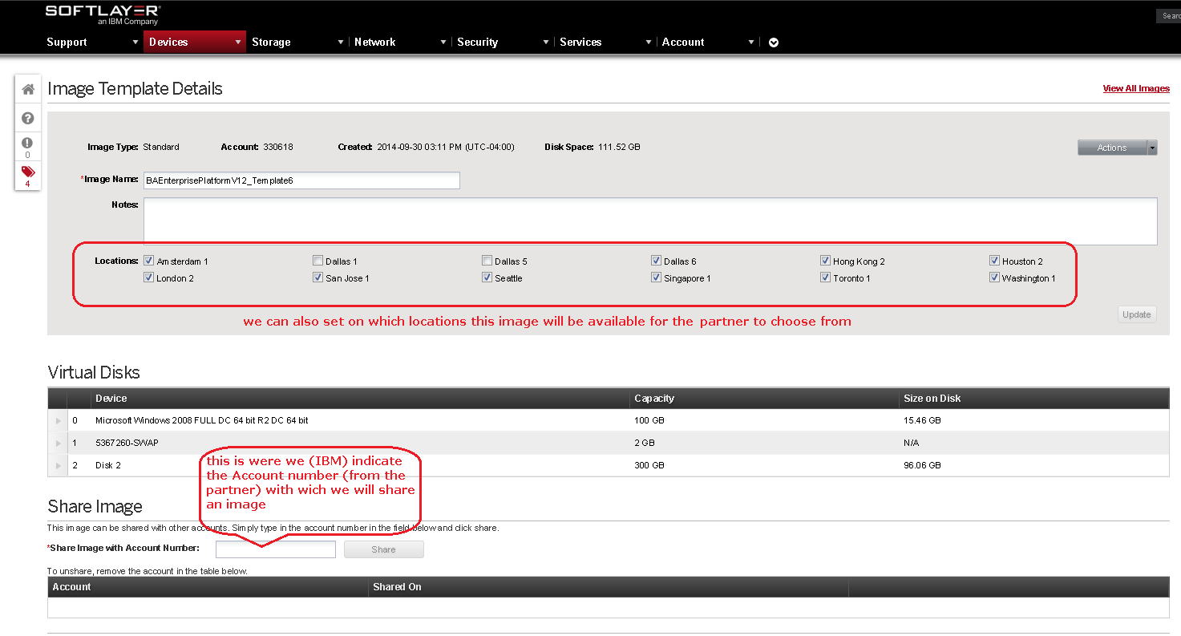
IBM can share the Demo Images with partners so that they can provision them on their own SoftLayer virtual servers.
Partner must have an opened account with SoftLayer and provide us their account number so that we can share based on that account as described below:
Contact your IBM partner manager and provide us your account number and what images you would like to have available.

Slide 10
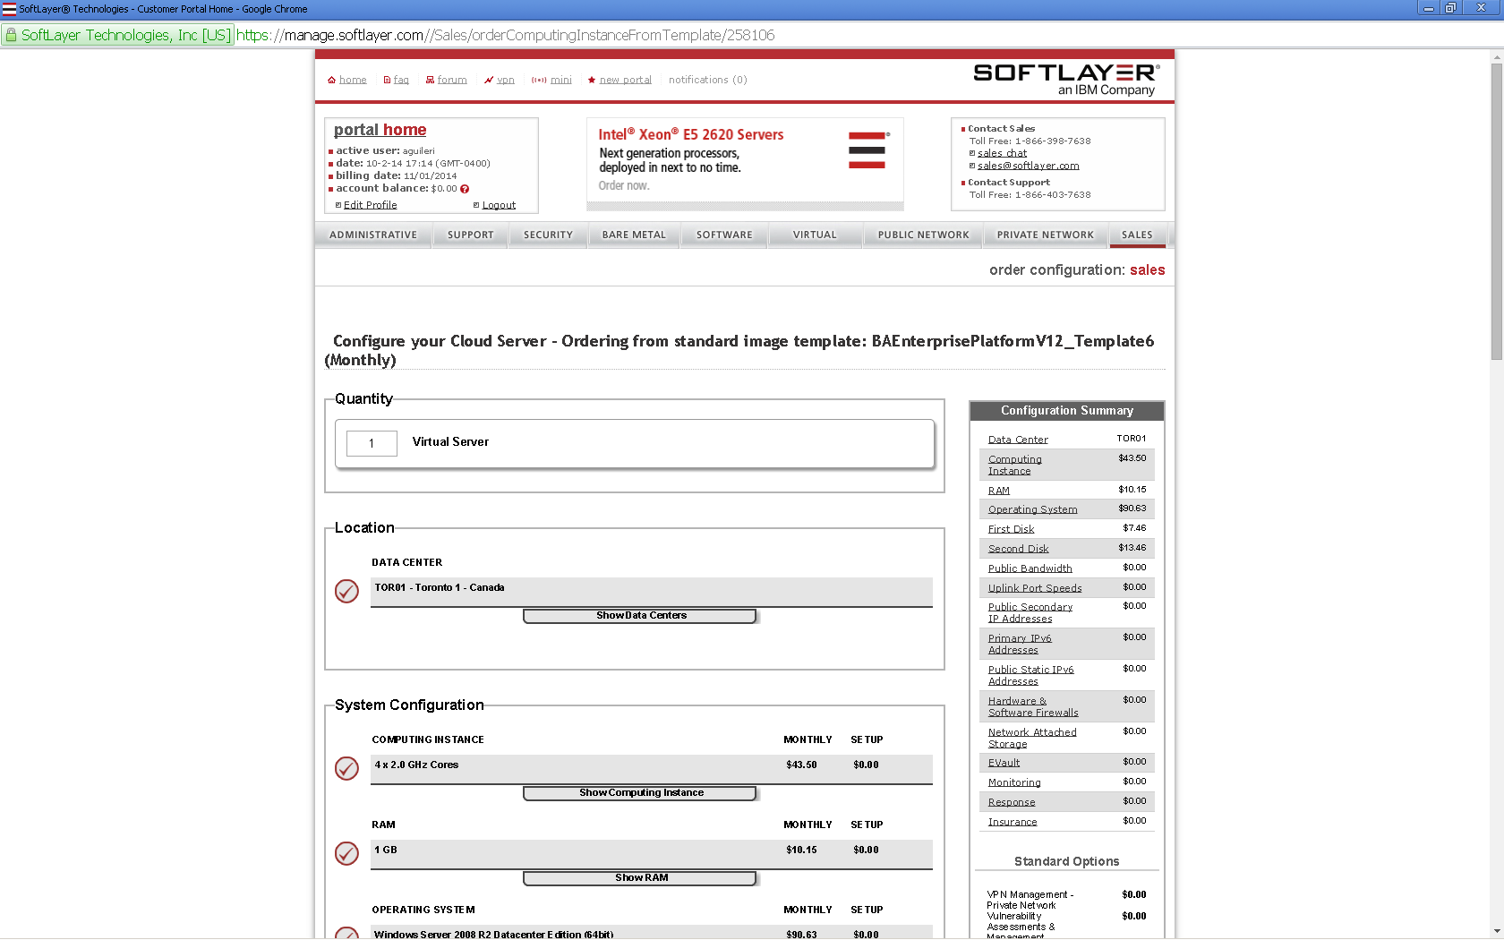
After creating your account, the first step is to choose the characteristics of the server that will host such image

Slide 11
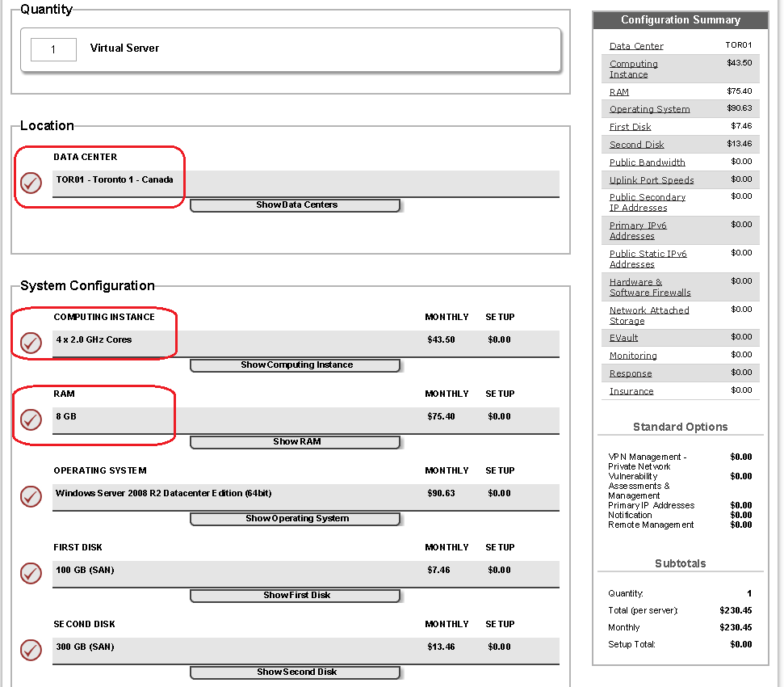
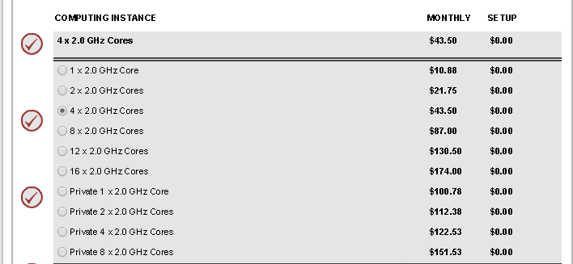
1- Must choose a data center from the list (there are many SL Servers all around the world)
2- Number of CPU’s (IBM Demo images are set at 4 cpus)
3- Amount of RAM desired (IBM Demo images have 8 GB of RAM)

Slide 12
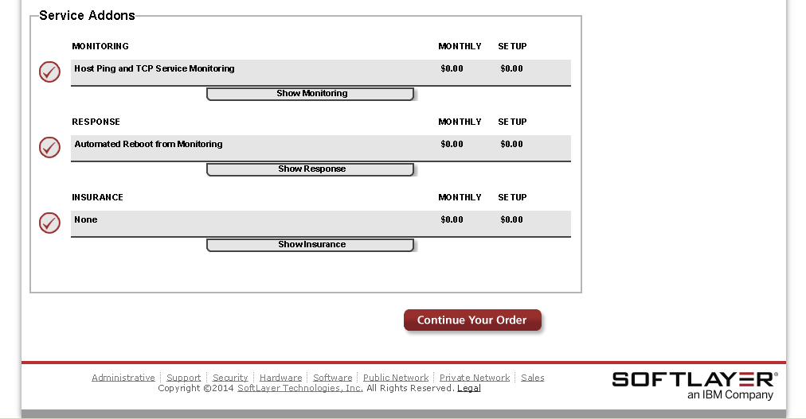
Finish filling up your settings, most can be left as default, click continue and submit.

Slide 13
Leverage your SoftLayer Account

Slide 14
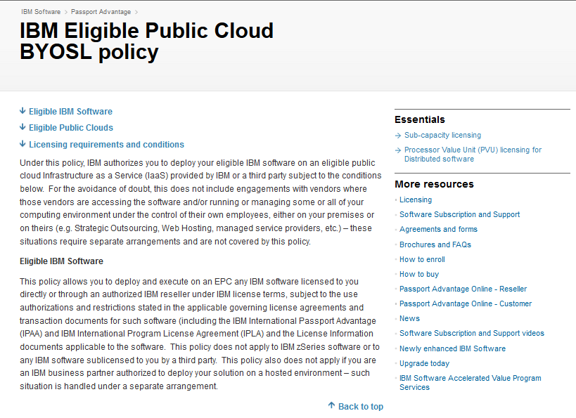
http://www-01.ibm.com/software/passportadvantage/eligible_public_cloud_BYOSL_policy.html

Slide 15
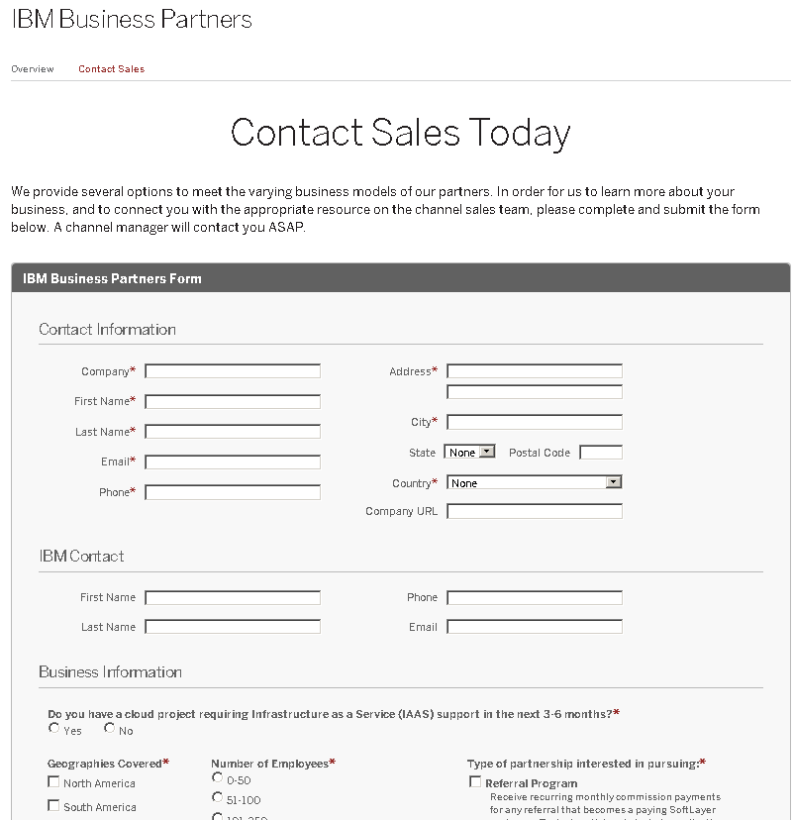
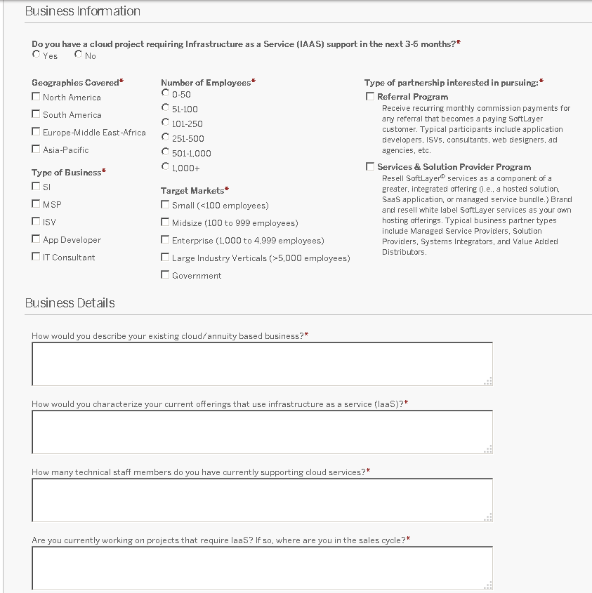
Want to sell YOUR solution on top of SoftLayer?
http://www.softlayer.com/ibm-business-partners/apply
Please make sure you fill in all the requested fields and describe your business needs.

Slide 16


